Slide 1

CRUD operations in MongoDB

Slide 2
CRUD operations in MongoDB
CRUD
CREATE
READ
UPDATE
DELETE

Slide 3
Create Operation
This command help to add new document to the collections. We used insertOne() and insertMany() methods to perform insert operations in MongoDB.
Method | Description
db.collection_name.insertOne() | This Method is useful to insert single document in Collection.
db.collection_name.insertMany() | This method is useful to insert many documents in collection.

Slide 4
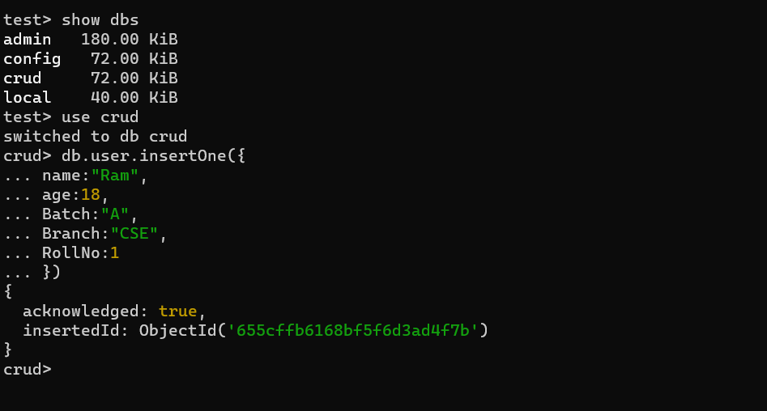
Example of InsertOne() Method

Slide 5
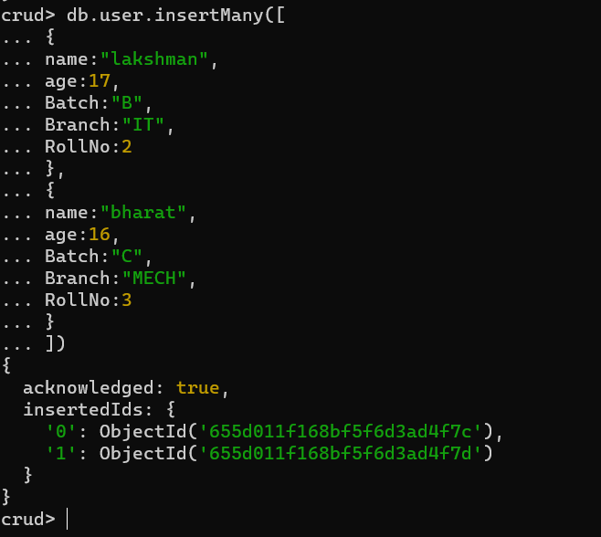
Example of insertMany() Method

Slide 6

Your turn to try…
You receive a new article titled "Introduction to MongoDB" written by "John Doe." The main content of the article covers the basics of MongoDB as a NoSQL database. The article is tagged with "MongoDB," "NoSQL," and "Database." It was published on January 1, 2023, at midnight (UTC), and initially, it has zero views.
Write a MongoDB insertOne operation to add
this new article to the "articles" collection.
Include the necessary fields such as title,
author, content, tags, published date, and views.
Notes:
Answer:
db.articles.insertOne({
title: "Introduction to MongoDB",
author: "John Doe",
content: "MongoDB is a NoSQL database...",
tags: ["MongoDB", "NoSQL", "Database"],
publishedDate: ISODate("2023-01-01T00:00:00Z"),
views: 0
})

Slide 7
Apply
You are tasked with inserting multiple documents into a MongoDB collection named "orders." Which command is appropriate for this batch insert operation?
A) db.orders.addMany(orderDataArray)
B) db.orders.insertAll(orderDataArray)
C) db.orders.insertMany(orderDataArray)
D) db.orders.createBatch(orderDataArray)
C

Slide 8
Understand
In MongoDB, what is the purpose of the _id field when performing a create operation?
A) It is optional and can be omitted.
B) It must be manually generated by the user.
C) MongoDB automatically generates a unique _id if not provided.
D) It is used to specify the collection name.
C

Slide 9


Slide 10

Read Operation
read operations are used to retrieve data from the database. The primary command for read operations is find(), which allows you to query the collections to retrieve documents that match certain criteria.

Slide 11
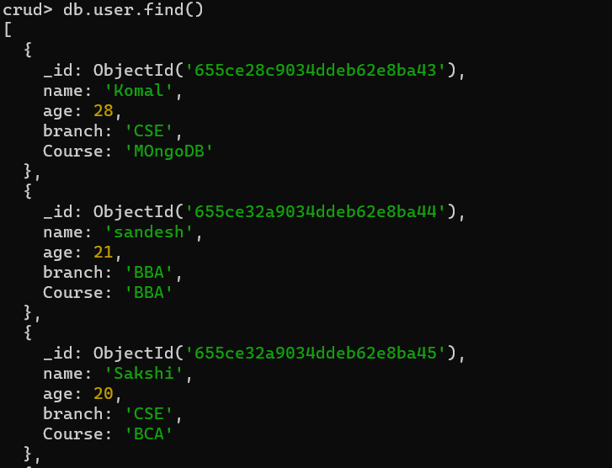
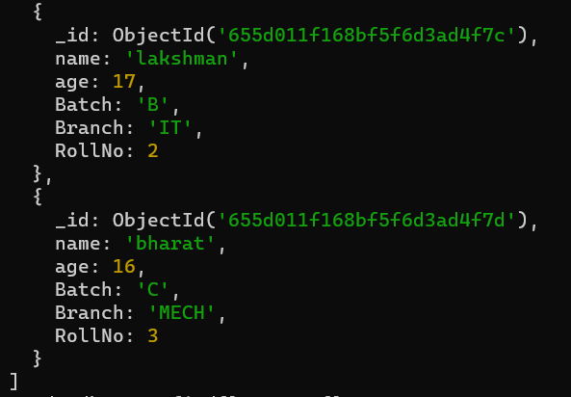
Find all the documents in collections
Use db.collection_name.find() method to get all documents from collections.

Slide 12
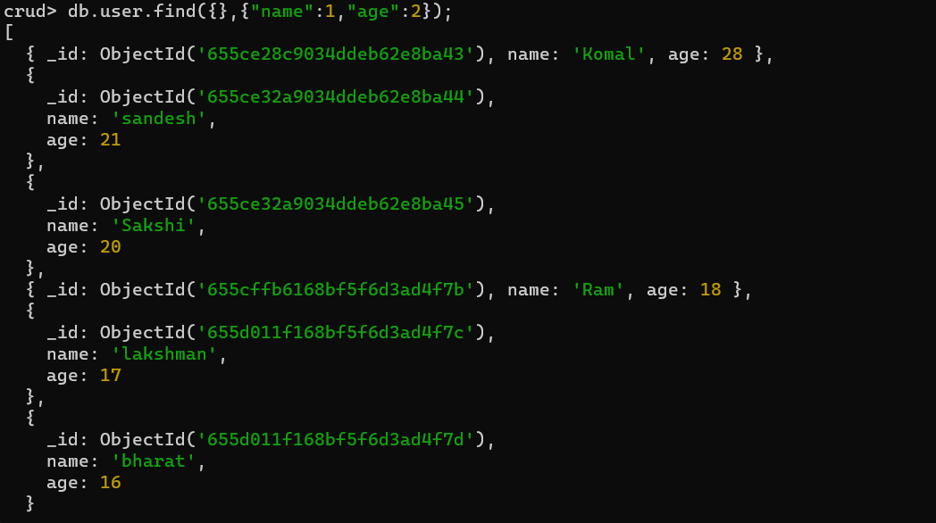
Find the Specific Field from Document
Use this command to get specific field from document
db.collectionName.find({}, { key1: 1, key2: 1 });
It will return only key1 and key2 value from document.

Slide 13
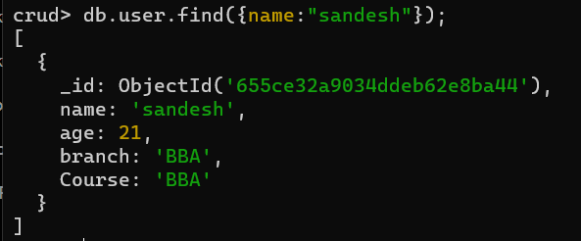
Filter documents based on a condition
db.collectionName.find({ key: value });
Use this command to get the documents where the value of the field key is equal to the specified value.

Slide 14
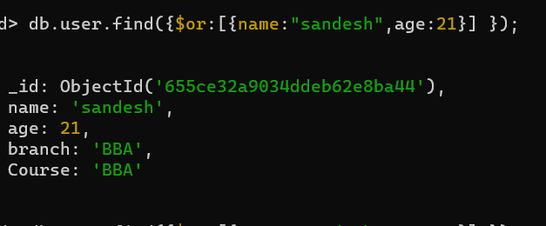
Using logical operators
db.collectionName.find({ $or: [{ key1: value1 }, { key2: value2 }] });
This commands returns documents where either key1 is equal to value1 or key2 is equal to value2.

Slide 15
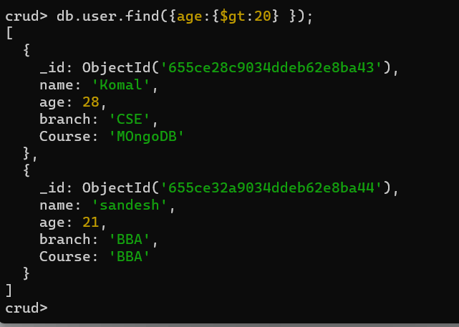
Comparison Operator
db.collectionName.find({ age: { $gt: 25 } });
This will return documents where the value of the age field is greater than 25.

Slide 16
List of Comparison Operators
Equal to:
Syntax: { field: value } or { field: { $eq: value } }
Not equal to:
Syntax: { field: { $ne: value } }
Greater than:
Syntax: { field: { $gt: value } }
Greater than or equal to:
Syntax: { field: { $gte: value } }
5) Less than:
Syntax: { field: { $lt: value } }
6) Less than or equal to:
Syntax: { field: { $lte: value } }
7) In array:
Syntax: { field: { $in: [value1, value2, ...] } }
8) Not in array:
Syntax: { field: { $nin: [value1, value2, ...] } }
9) Exists:
Syntax: { field: { $exists: true/false } }

Slide 17
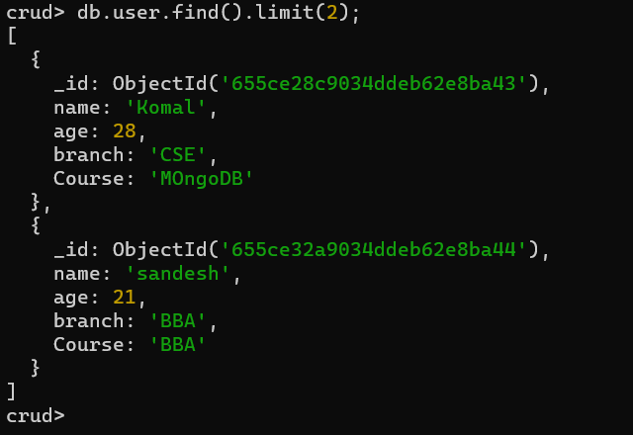
Limit the number of documents returned
db.collectionName.find().limit(5);
This will return only the first 5 documents.

Slide 18
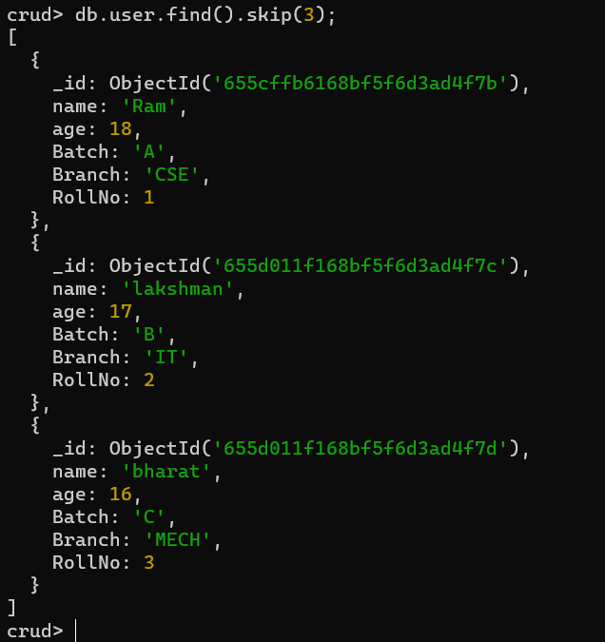
Skip a certain number of documents:
db.collectionName.find().skip(10);
This query will skip the first 10 documents and print remaining all.

Slide 19

Count the number of documents:
db.collectionName.find().count();
This will count how many documents are present in the collection.

Slide 20
Apply
Which MongoDB method is used to limit the number of documents returned in a query?
A) limit()
B) count()
C) retrieve()
D) filter()
A

Slide 21
Apply
Which MongoDB query operator is used for specifying an equality condition?
A) $eq
B) $ne
C) $gt
D) $lt
A

Slide 22
Update Operation
In MongoDB, the update operation is used to modify existing documents in a collection. There are several ways to perform update operations, and MongoDB provides methods like updateOne(), updateMany(), and update().

Slide 23
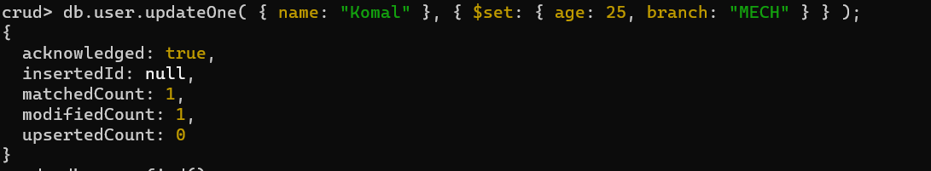
updateOne() Method
The updateOne() method updates a single document in a collection that matches the specified filter.
db.collectionName.updateOne(
{ filter_criteria },
{ $set: { field1: value1, field2: value2, ... } }
);

Slide 24
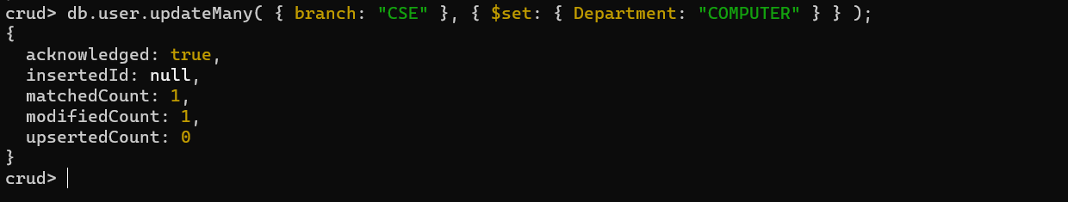
updateMany() Method
The updateMany() method updates all documents in a collection that match the specified filter.
db.collectionName.updateMany(
{ filter_criteria },
{ $set: { field1: value1, field2: value2, ... } }
);

Slide 25
Understand
What does the updateMany() method do in MongoDB?
A) Updates a single document in a collection
B) Updates all documents in a collection that match a filter
C) Updates the first document in a collection
D) Adds a new document to a collection
B

Slide 26
Delete Operation in MongoDB
The delete operation is used to remove documents from a collection. There are two primary methods for performing delete operations: deleteOne() and deleteMany().

Slide 27
deleteOne() Method
The deleteOne() method removes a single document from a collection that matches the specified filter.
db.collectionName.deleteOne({ filter_criteria });

Slide 28

deleteMany() Method
The deleteMany() method removes all documents from a collection that match the specified filter.
db.collectionName.deleteMany({ filter_criteria });

Slide 29
Mini Project
Title:Todo List Application with MongoDB CRUD Operations
Document structure:
{
"_id": ObjectId("..."),
"title": "Task Title",
"description": "Task Description",
"completed": false
}
Notes:
Student will get brief knowledge about crud operations after performing this mini project.

Slide 30
Mini Project
Tasks:
1. Create Operation: Add a New Task
Insert a document into the todos collection with the following details:
Title: "Complete Project"
Description: "Finish the mini project on CRUD operations."
Completed: false
2. Read Operation: View All Tasks
Retrieve and display all tasks from the todos collection.

Slide 31
Mini Project
3. Update Operation: Mark a Task as Completed
Update the task with the title "Complete Project" to mark it as completed.
4. Read Operation: View Completed Tasks
Retrieve and display all completed tasks from the todos collection.
5. Update Operation: Update Task Description
Update the task with the title "Complete Project" to change its description to "Finish the mini project on CRUD operations in MongoDB."

Slide 32
Mini Project
6. Read Operation: View Specific Task
Retrieve and display the details of the task with the title "Complete Project."
7. Delete Operation: Remove Completed Tasks
Delete all tasks from the todos collection that are marked as completed.
8. Read Operation: View Remaining Tasks
Retrieve and display all remaining tasks from the todos collection.

Slide 33


Slide 34
Thank You

